Slide 1
Topic : Customer Segmentation and Content-Based Image Retrieval for Fashion Products
Deep Learning Project : 12/05/2024
TEAM :
BP Shashidhar Reddy
Vishakha Maruti Sonmore
Aastha Dinesh Singh Kshatriya
Hari Haran Dhulipala

Slide 2
Introduction
The e-commerce industry is rapidly transforming, with the global market expected to reach $7.4 trillion by 2025 and over 22% of retail sales happening online. To stay competitive, businesses must predict customer behavior and enhance personalization.
Our project addresses these challenges by using structured transaction data for predictive modeling and unstructured image data for a content-based image retrieval system.
This approach combines machine learning and deep learning to anticipate product preferences, deliver personalized experiences, and enable users to discover visually similar products effortlessly, boosting customer satisfaction and engagement.

Slide 3
Problem Statement
E-commerce platforms struggle to utilize vast data for actionable insights and personalized recommendations.
Growing demand for visual search (preferred by 62% of millennials and Gen Z) drives innovation needs.
Predictive modeling and deep learning boost personalization and revenue by 8-12%.

Slide 4
Patterns, precision and problem-solving
Predictive Modeling Using Decision Tree Classifier
Sales Forecasting Using Random Forest Regressor
Fashion Visual Search Model using pre-trained CNN and KNN

Slide 5
Dataset -1
Machine Learning
Ecommerce data
51,290 rows
21 columns
Features like Order ID, Order Date, Product Category, Sales, Quantity, Profit, Region etc.
Dataset -2
Deep Learning
44,441 Images, Unstructured data
The dataset contains various images of different e-commerce products like clothes, beauty products, shoes etc.

Slide 6
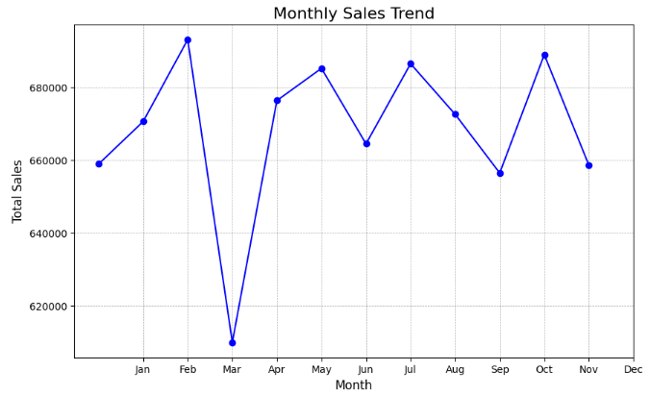
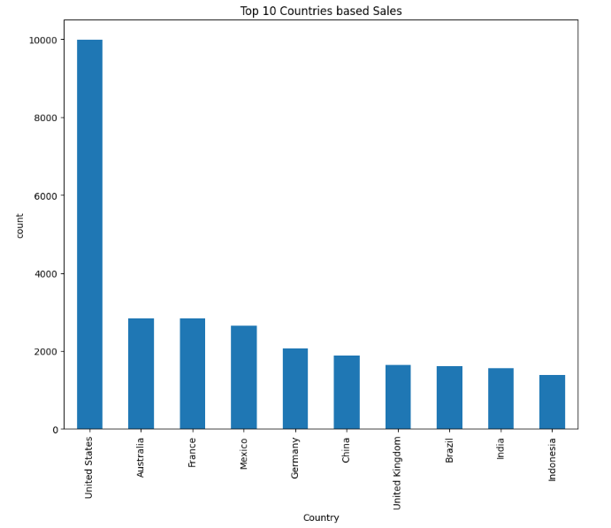
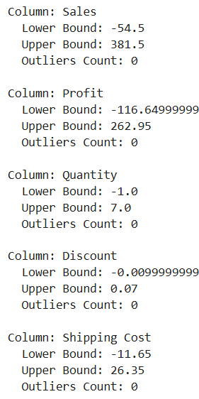
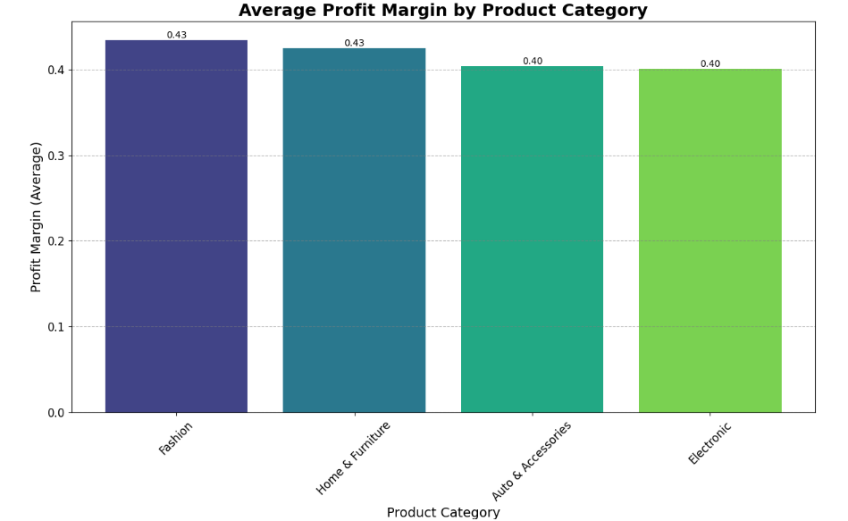
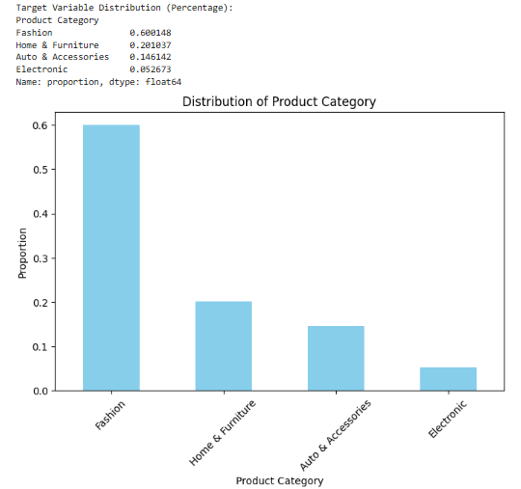
Dataset 1 : Visualizations
Detect outliers using IQR

Slide 7
Predictive Modeling Using Decision Tree Classifier
WHY DECISION TREE ?
Predict the most likely product category a customer will purchase next based on their past behavior. This helps businesses anticipate needs, personalize marketing, and improve product recommendations.
Derived Insights and Business Applications
Key Drivers of Customer Preferences
Improved Inventory Management
Effective Pricing & Discount Strategies

Slide 8
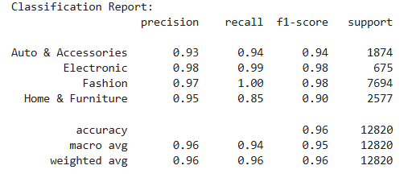
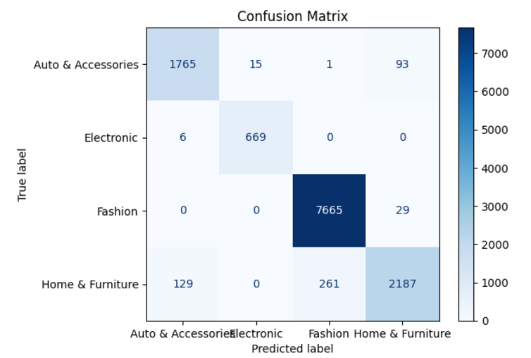
Predictive Modeling Using Decision Tree Classifier : RESULTS

Slide 9
Sales Forecasting Using Random Forest Regressor
WHY RANDOM FOREST?
The goal of this analysis is to forecast future sales volume for each product category using historical sales data. Accurate sales forecasts are crucial for inventory management, optimizing marketing strategies, and planning promotional campaigns.
Derived Insights and Business Applications
Accurate Sales Forecasts
Understanding Key Drivers
Actionable Recommendations

Slide 10
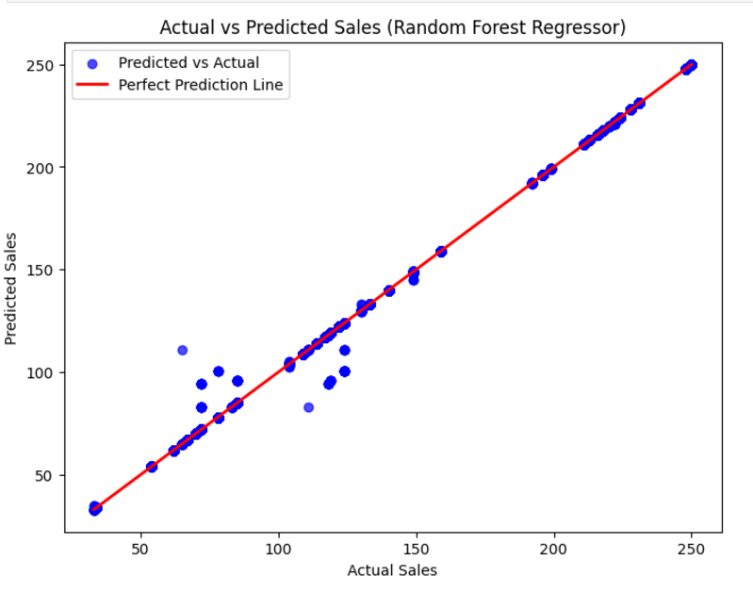

Sales Forecasting Using Random Forest Regressor RESULTS

Slide 11
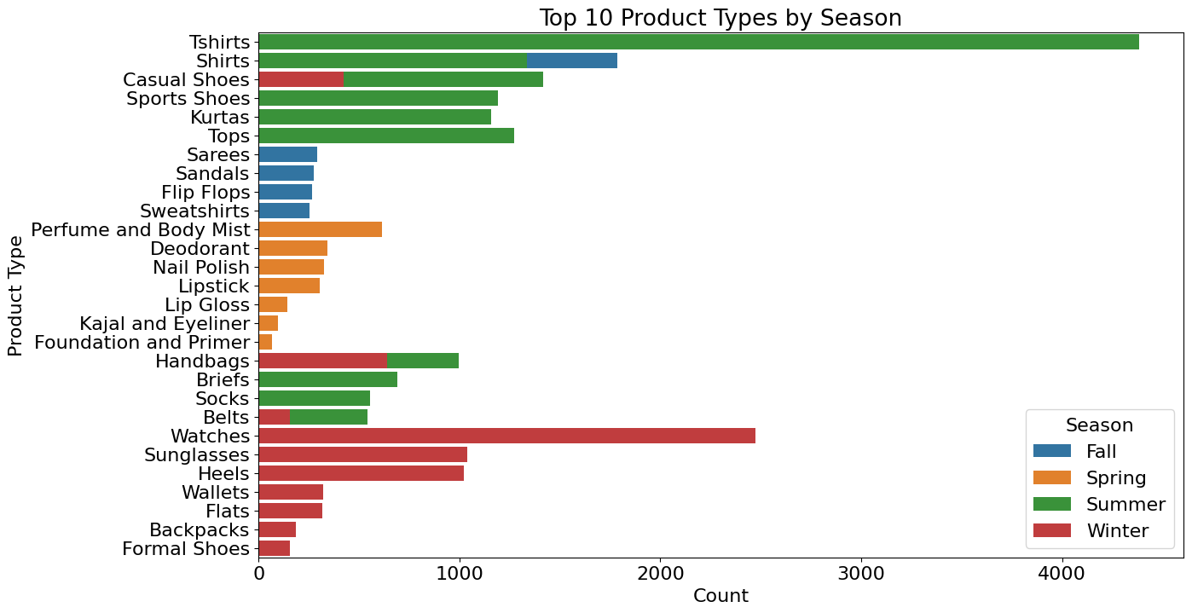
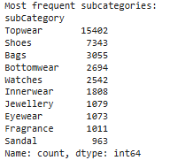
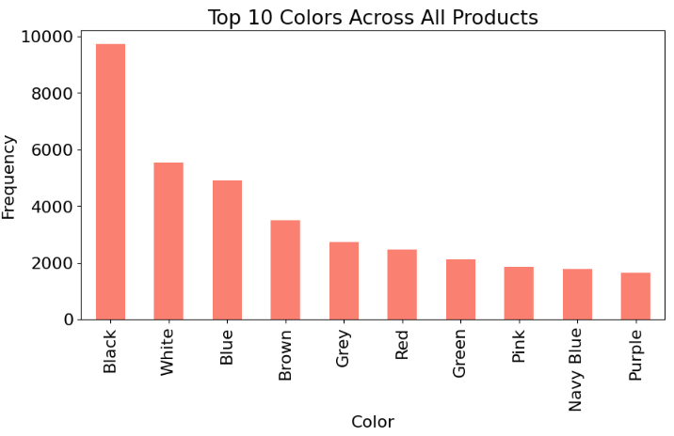
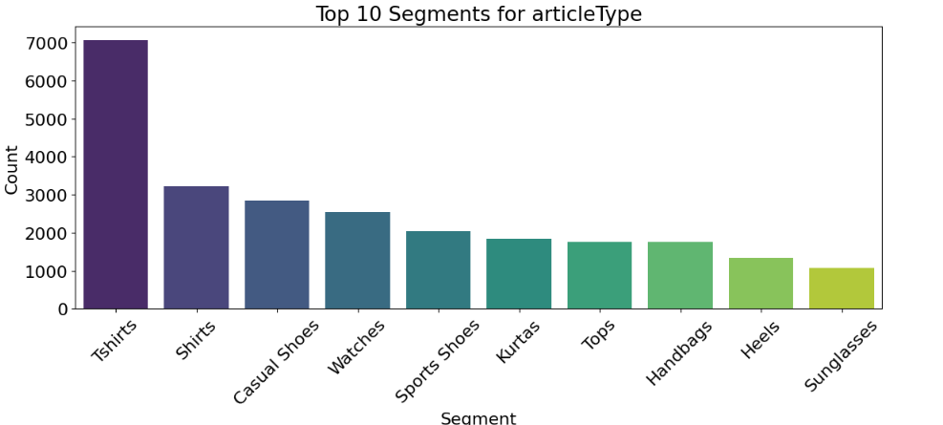
Dataset 2 : Visualizations

Slide 12
Fashion Visual Search Model using pre-trained CNN and KNN
Feature Extraction Using CNN
We employed a pre-trained CNN as the backbone for feature extraction.
The CNN is used to generate feature embeddings.
VGG16.
Similarity Search Using KNN
The embeddings generated by the CNN are used as input for a KNN classifier.

Slide 13
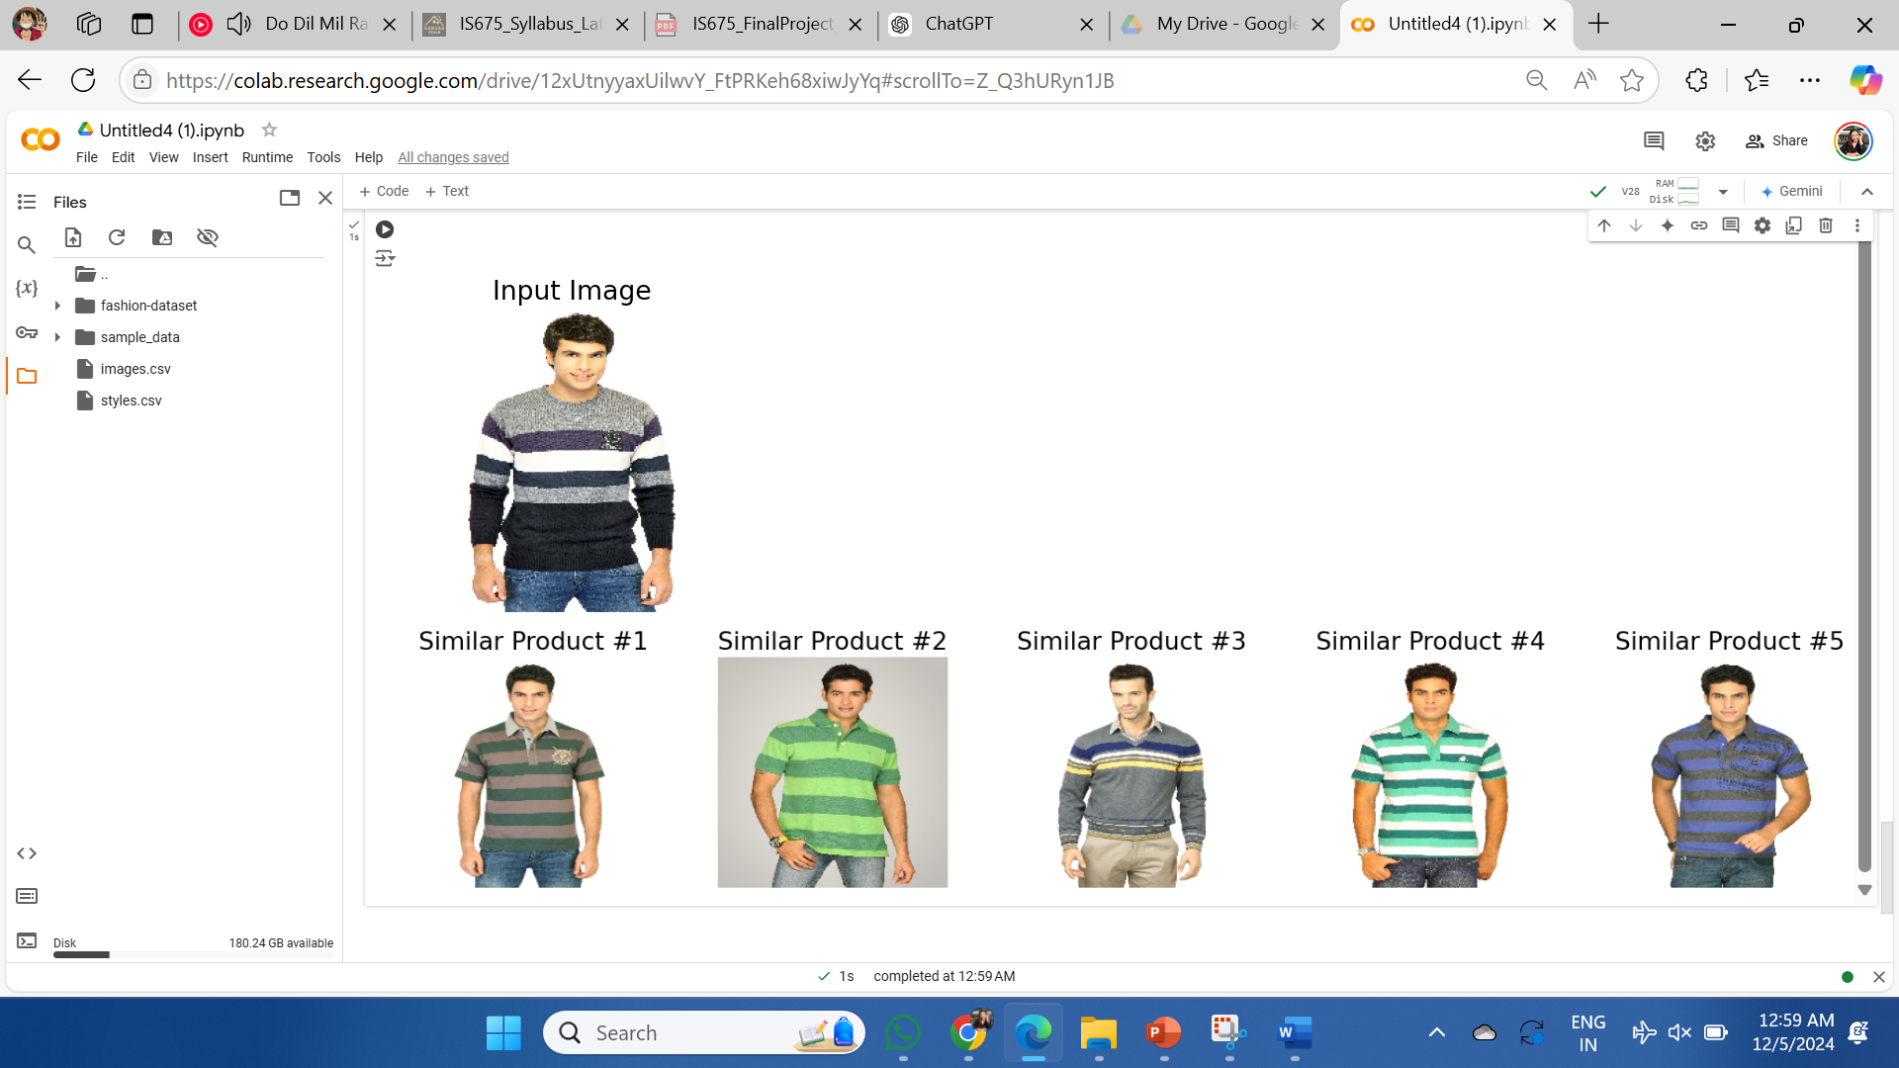
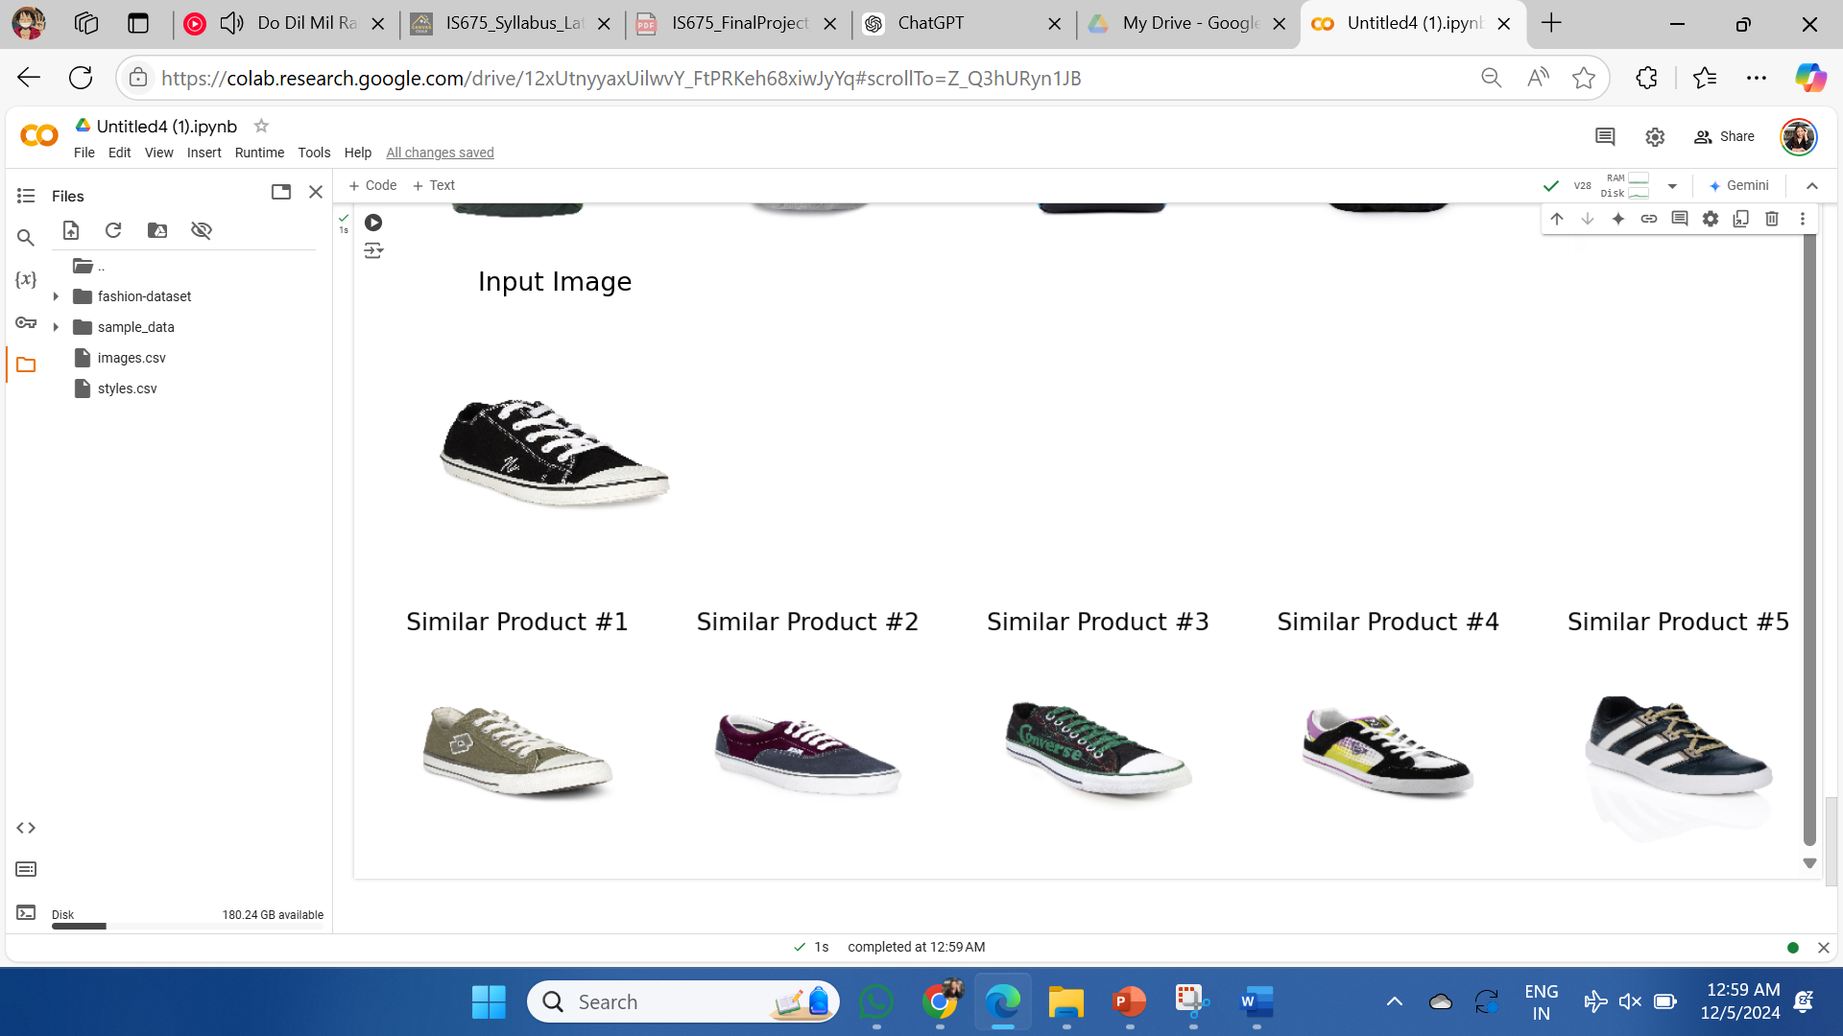
Fashion Visual Search Model using pre-trained CNN and KNN : RESULTS

Slide 14
Conclusion
This model bridges the gap between what a customer wants and what the catalog offers by relying on visual cues rather than textual descriptions.
By analyzing the retrieved items for frequently searched products, we can identify top trends and optimize our inventory to meet customer demand.
Through visual similarity, we can promote items that might have otherwise gone unnoticed, increasing sales and reducing unsold inventory.
“

Slide 15
Thanks!
Do you have any questions?

